Slide 1

Equal Rights for All?
The ERA in the 21st Century
Emily Schnurr, PhD Student
Grant Walsh-Haines, Graduate Teaching Scholar
Northern Arizona University
Department of Politics & International Affairs

Slide 2

Overview
What are the rules of the game?
Why is the ERA (still) important?
What will it take to pass the ERA?

Slide 3

What are the Rules of the Game?

Slide 4
The Equal Rights Amendment
Section 1: Equality of rights under the law shall not be denied or abridged by the United States or any state on account of sex.
Section 2: The Congress shall have the power to enforce, by appropriate legislation, the provisions of this article.
Section 3: This amendment shall take effect two years after the date of ratification.

Slide 5
What is an Amendment?
An improvement, correction or revision to the original content of the 1788 Constitution.
27 Amendments have been included to the Constitution.

Slide 6
The Ratification Process
Two Options:
  Approval by 2/3 of both chambers of Congress, and ratification by ¾ of state legislatures.
  A Constitutional Convention to be called by 2/3 of the legislatures of the states, amendments ratified by ¾ of states.
    This method has never been used

Slide 7
The Ratification Process, cont.
Legislation introduced in the House or Senate
Amendment is approved in the first chamber
Amendment is approved in the second chamber
Each state must introduce legislation in both the state house and senate
The amendment must be approved by both state chambers
38 states must approve the amendment in order for it to take effect

Slide 8
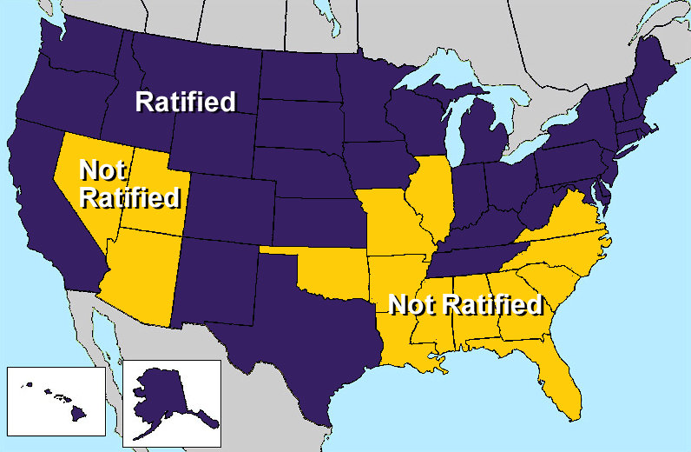

Slide 9
Ratification Issues
Introduced in 1923, passed by Congress in 1972.
7 year time limit has been extended several times.
Only 3 states are needed to ratify this amendment.
The Madison Amendment

Slide 10

Why is the ERA (still) Important?

Slide 11

“The ERA remains the best option to overcome the inability of existing equal protection jurisprudence to achieve rigorous protection against sex discrimination” (Stephens, 2015).

Slide 12
Litigation Losses
United States v. Morrison (2000)
Gonzales v. Carhart (2007)
Ledbetter v. Goodyear Tire and Rubber, Inc (2007)
Wal-Mart Stores, Inc. v. Dukes (2011)
Vance v. Ball State University (2013)
Burwell v. Hobby Lobby (2014)

Slide 13
Opposition to the ERA
Phyllis Schlafly/STOP ERA/Eagle Forum
  Certain groups abandoned
    Women in custody battles
    Widows of veterans
  Same-sex marriage, Single-sex bathrooms…
Concerned Women for America
  Feminism is ‘anti-family’
  Men and women are fundamentally different and therefore ought to be treated differently under the law

Slide 14
Why We Need the ERA
Gender neutral language encourages unfavorable legal interpretations
Reproductive rights are still at risk
Would institutionalize gender based protections
Some laws that specifically protect women perpetuate stereotypes about men and women
Supreme Court compelled to apply strict scrutiny to cases involving sex discrimination

Slide 15
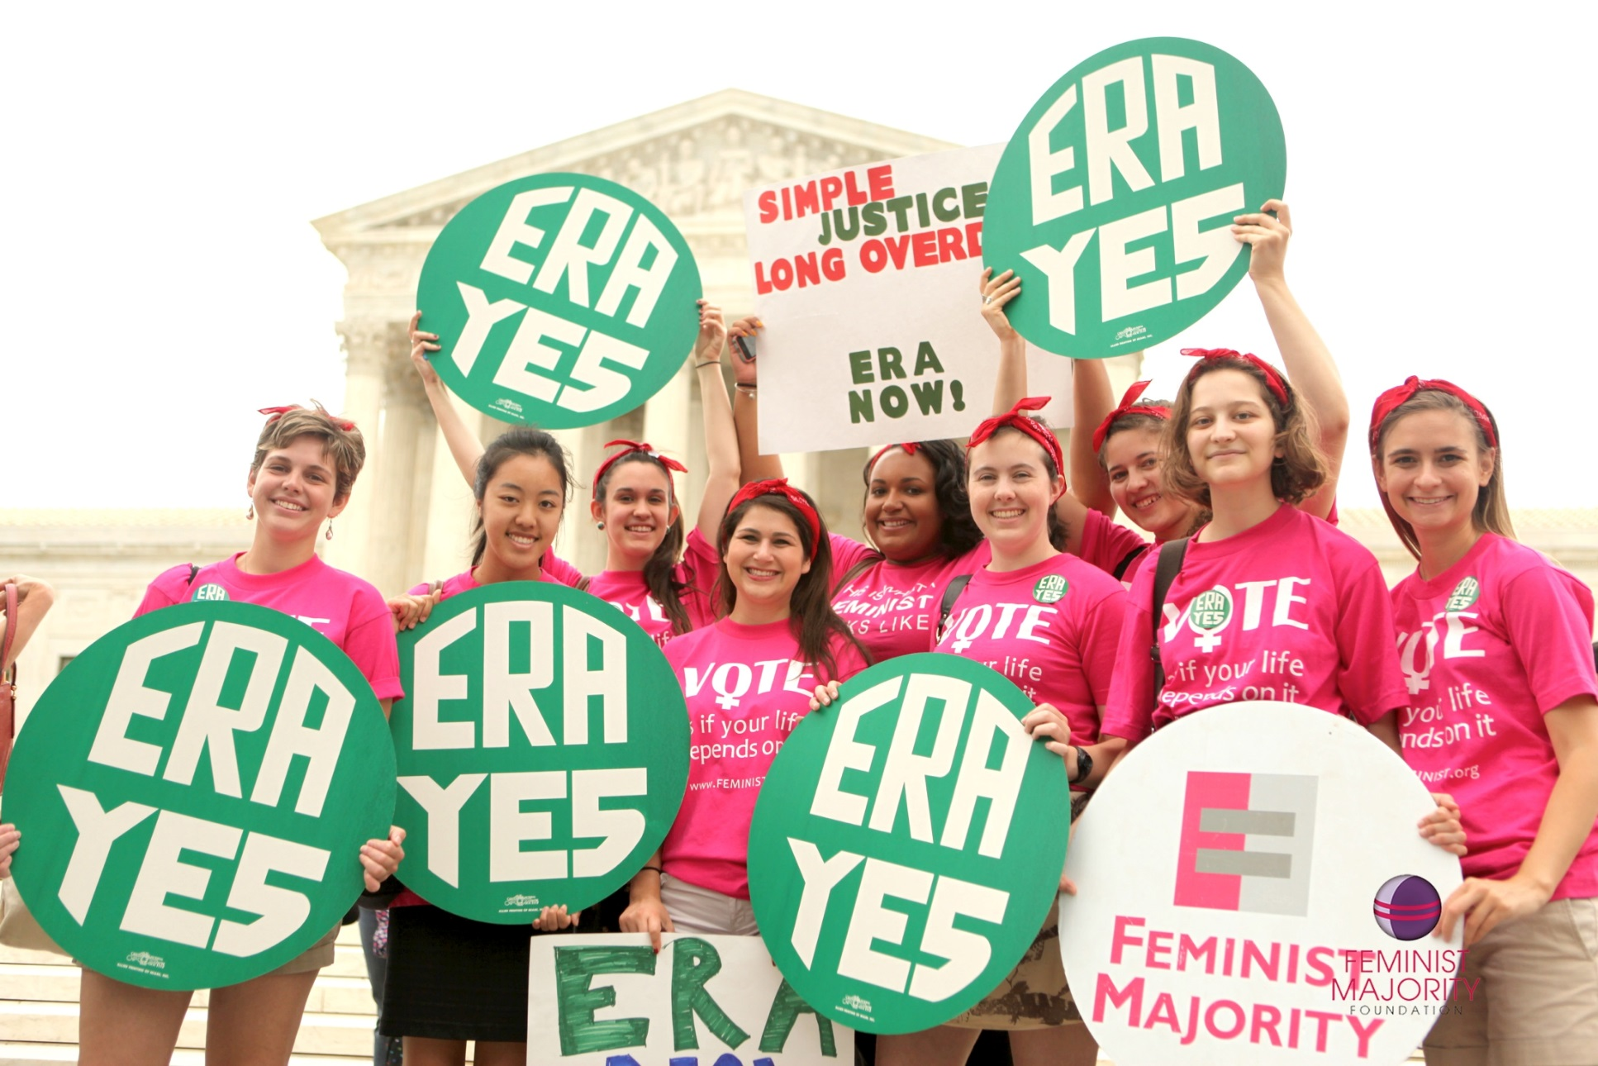
What will it take to Pass the ERA?

Slide 16
The Three State Strategy
Rescinding ratification—Do the 35 state votes still count?
  Idaho v. Freeman (1981) determined that states may rescind their support for ERA
  Case was deemed ‘moot’
The three state strategy requires closing the gap… but then what?
  Will Congress pass a new ratification deadline?
  Delegate a decision to Congress after three more states approve
  Legal viability of ‘deadlines don’t mean closure’ when issue remains sufficiently contemporaneous

Slide 17

What Can We Do in Arizona?
Can Arizona be one of the three states?

Slide 18
Strategies for Arizona
Education and Outreach
Social Networking and collective action in the streets
Dismantle the fear of feminism
Counter arguments against the ERA
Onboard conservatives in legislature
Coalition-building with conservative organizations opposed to the ERA

Slide 19
Thank You!
Questions?

